Slide 1

Real Robot Implementation

Slide 2

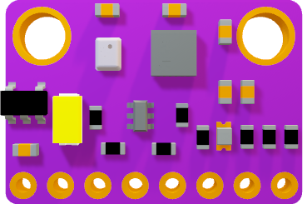
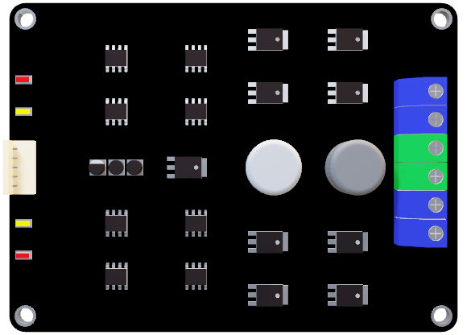
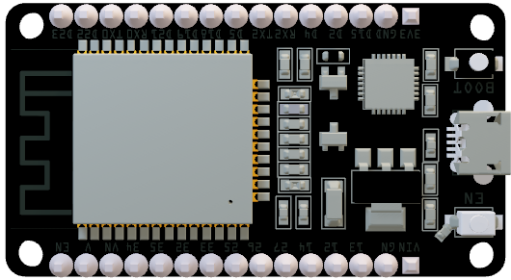
Embedded Layer

Slide 3
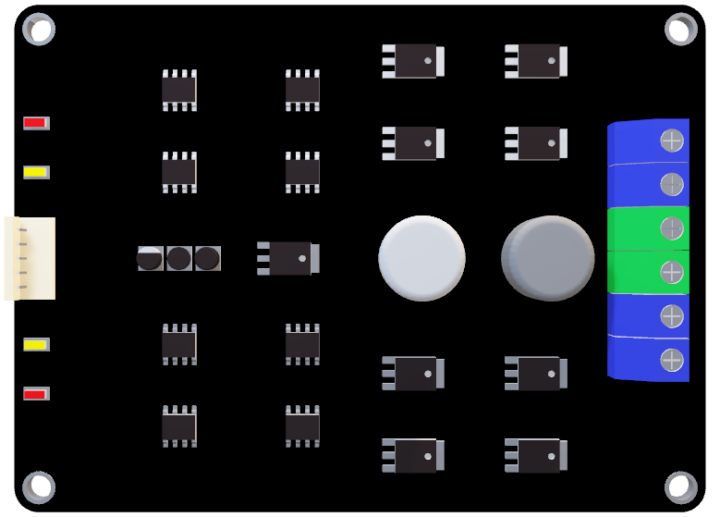
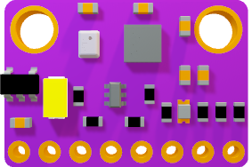
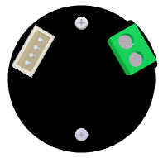
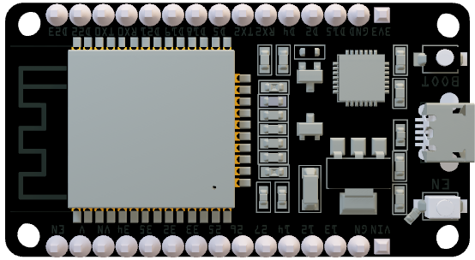
ESP32
MPU9250
Magnetic Encoders
Cytron MDD10A Driver

Slide 4
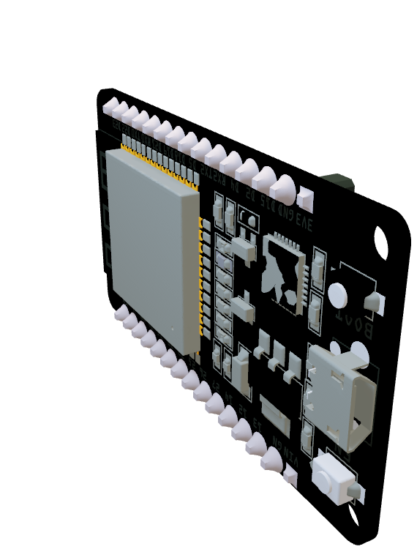
ESP32
Why ESP32?
After searching we saw that we can’t depend totally on Raspberry pi through all tasks. Because that’s design principle has many problem:

Slide 5
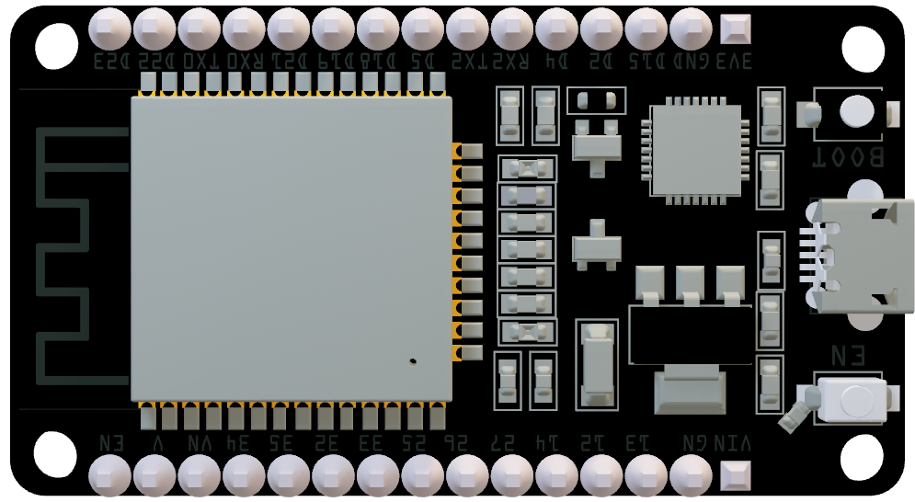
Complexity of accessing bare metal layer at Raspberry pi
Leakage of components libraries for Raspberry pi exactly those which in C++
Power Feedback mistakes which could may damage Raspberry in just a seconds

Slide 6

Positivity of using ESP32 rather than another MCUs

Slide 7

ESP32 is one of oldest MCU’s which has board manager at arduino IDE, that would provide us with many resources, libraries and community sup portMPU9250

Slide 8
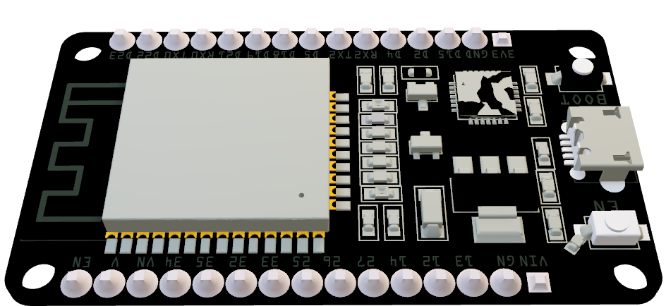
ESP32 is high performance because of it’s multi-core and low cost. So it’s reliable at variety of task especially those which in Real-time and No fear of damaging it while learning of wrong wiring because of its low cost

Slide 9

2. MPU9250
What is MPU9250?
MPU9250 is a combination of 3 sensors:
Accelerometer
Gyroscope
Magnetometer

Slide 10
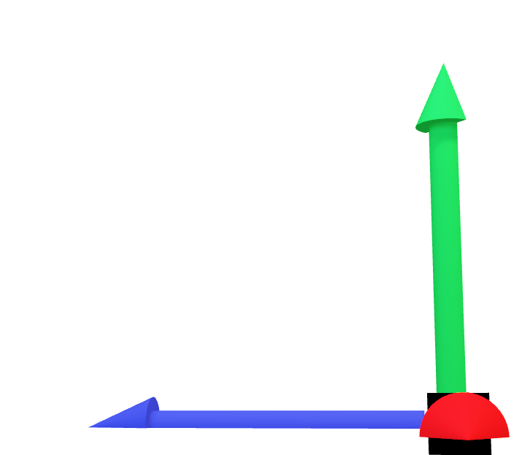

Accelerometer
It used for measuring acceleration on linear axis

Slide 11


It Uses micro electro-mechanical systems to measure linear acceleration

Slide 12

This MEM looks like comp with two faces and all its teeth surrounded by left teeth and right teeth and this comp has 4 swinging ends

Slide 13

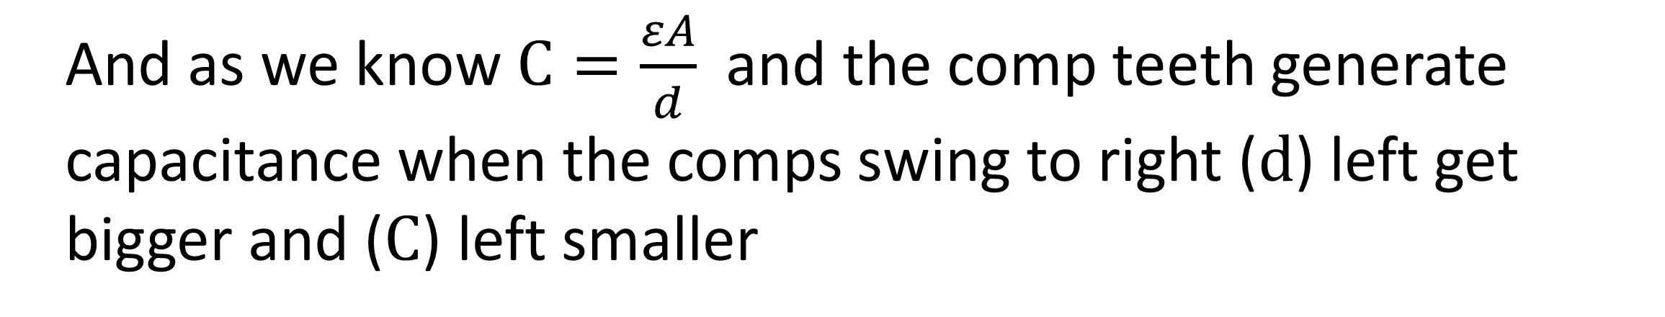
And as we know $C=\frac{εA}{d}$ and the comp teeth generate capacitance when the comps swing to right (d) left get bigger and (C) left smaller

Slide 14
when the comps swing to left (d) right get bigger and (C) right smaller

Slide 15
From this measures we can exactly measure the linear acceleration.

Slide 16
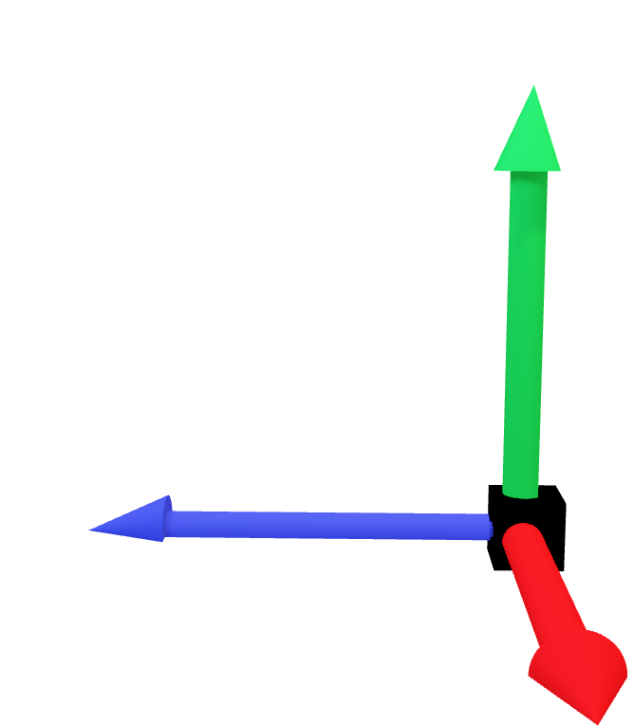
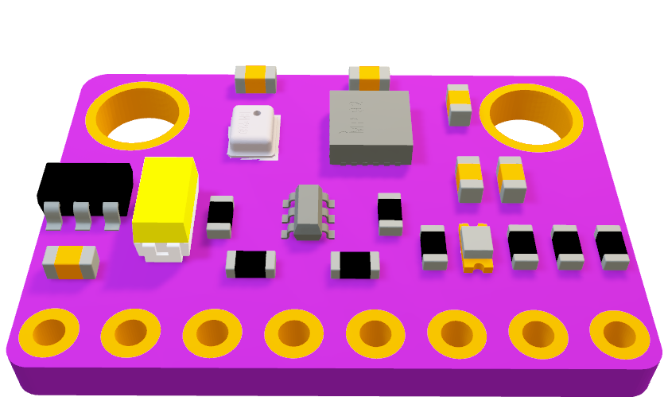
Gyroscope:
Gyro is used for measuring angular speed

Slide 17
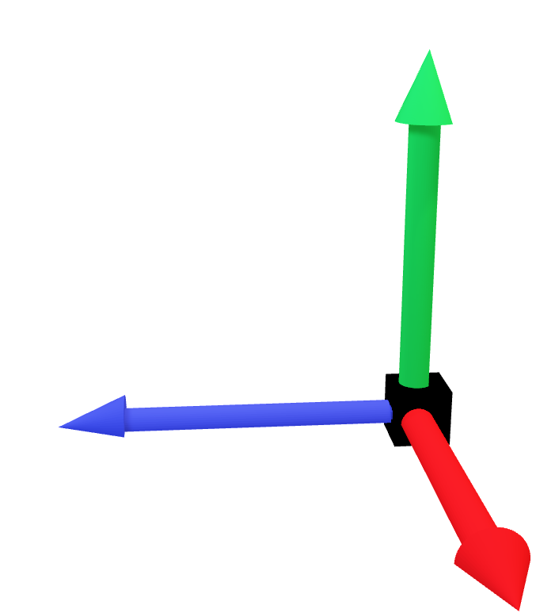

It also depends on MEMS. But now it use Coriolis acceleration. And Newton second’s law.

Slide 18
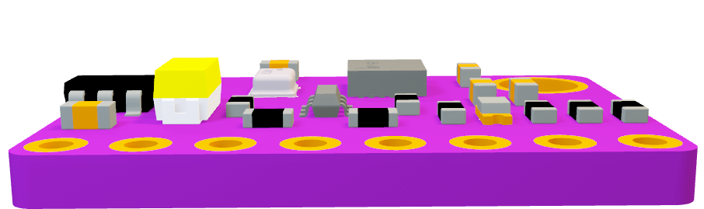
Coriolis assumed that a magnetic particle with known math rotates around core and its trajectory looks like circle

Slide 19
If this particle rotate with constant tangential velocity. And its distance away far of core increased. And it tried to keep its tangential velocity

Slide 20
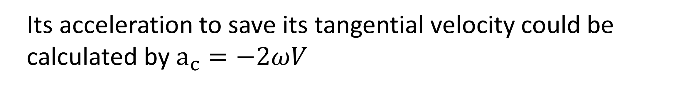
Its acceleration to save its tangential velocity could be calculated by $a_{c}=−2ωV$

Slide 21
And from newton’s 2nd law $f=ma$ , then $ω=\frac{f}{\left(−2V\right)m}$

Slide 22
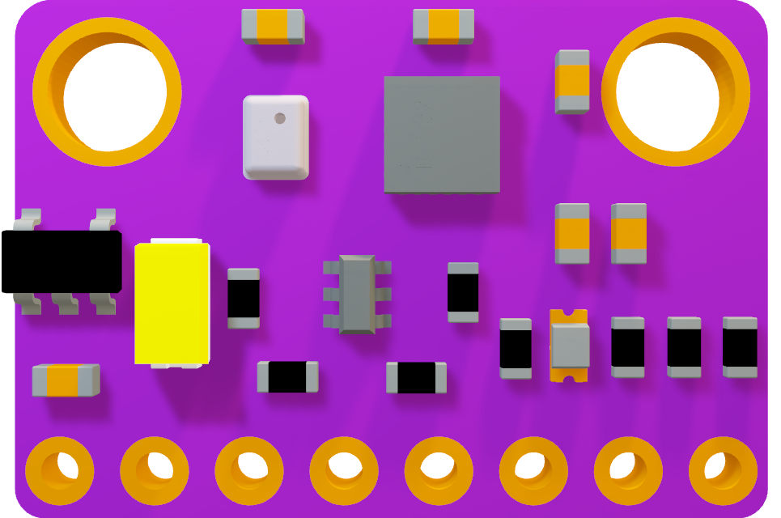
Magnetometer:
Its working principle is hall effect which can be used at measuring magnetic field strength and it would be very helpful at robot localization

Slide 23
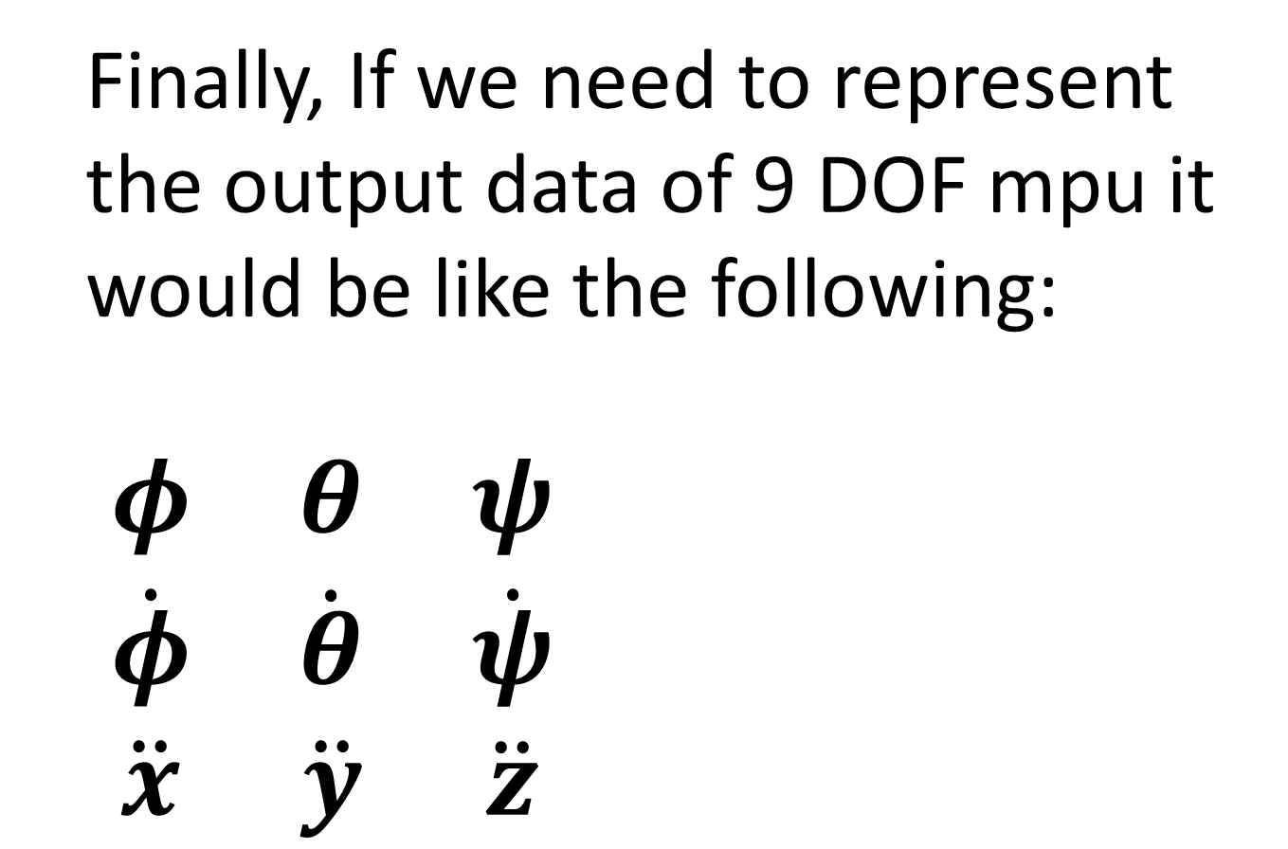
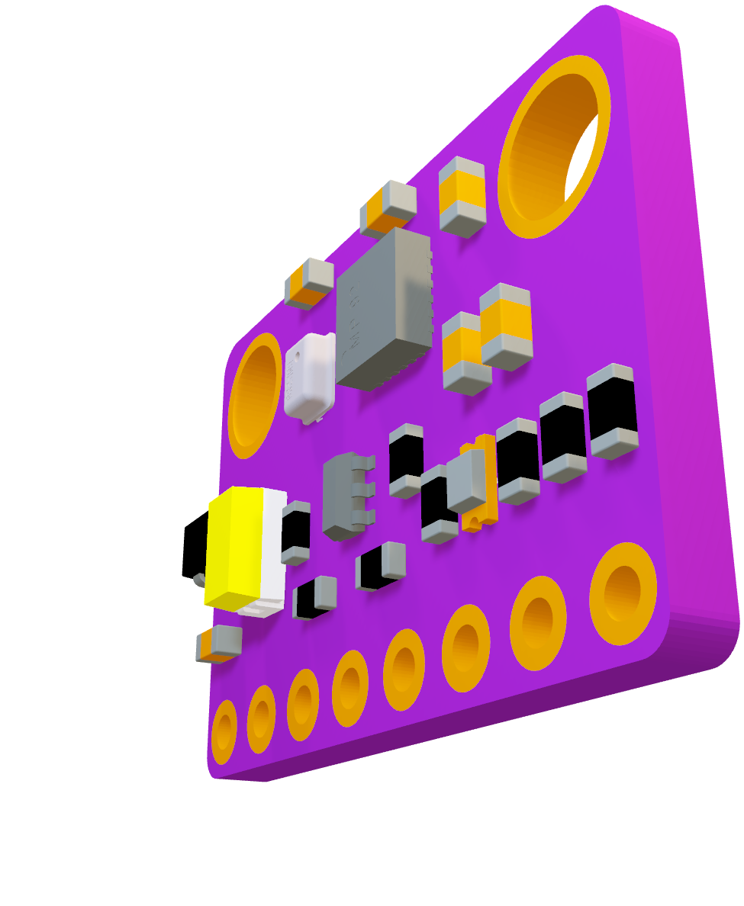
Finally, If we need to represent the output data of 9 DOF mpu it would be like the following:
$\begin{matrix}φ & θ & ψ \\ \dot{φ} & \dot{θ} & \dot{ψ} \\ \ddot{x} & \ddot{y} & \ddot{z}\end{matrix}$

Slide 24
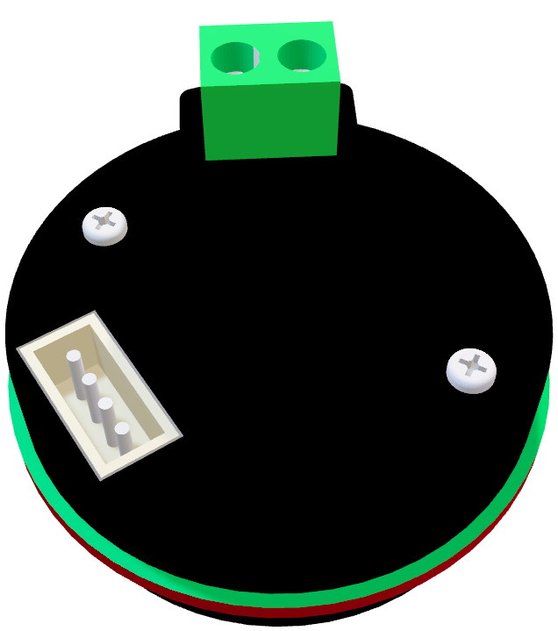
3. Magnetic Encoders:
It simply based on 2 hall effect sensors.

Slide 25
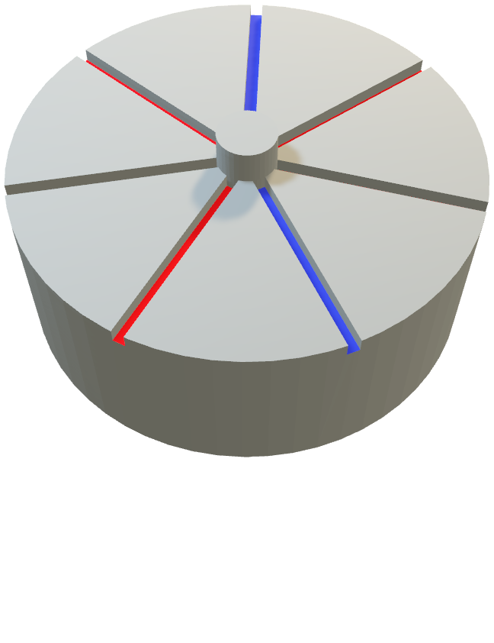
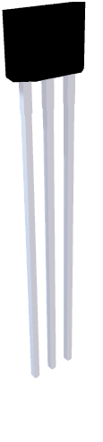

There is a core filled of magnetic slots when it starts of rotating because of attachment to motor rotor the hall effect sensor send pulses

Slide 26
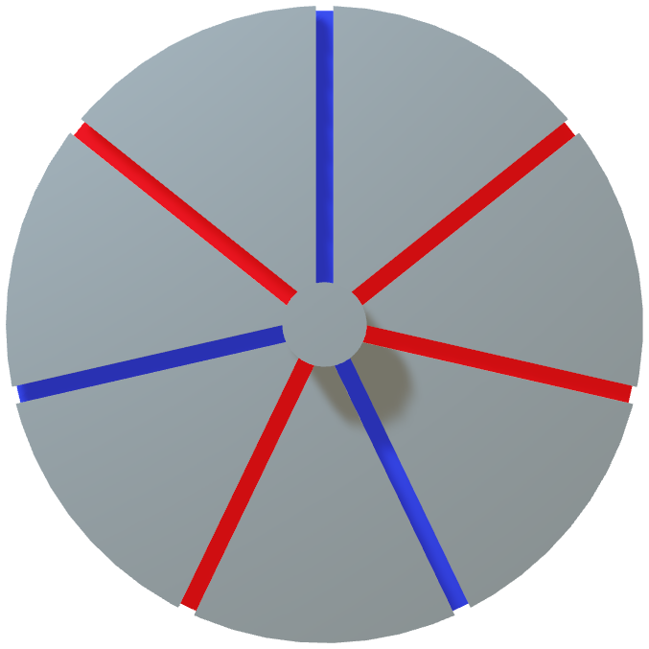

And according of known number of magnetic slices and counting hall effect pulses we can determine exactly how much the wheel rotated.

Slide 27

What about finding direction?
Easily because the existence of 2 hall effect sensors if the right-hand side pulsed first the motor would be rotate CW and if the left-hand side pulsed first then it has to be rotating CCW

Slide 28

And because of installing the 2 hall effect sensor with specific angular displacement. Always the first pulsed channel precede the second channel with half step

Slide 29

So the output at CCW
would be like:
B
A

Slide 30

So the output at CW
would be like:
B
A

Slide 31
B
And this phase shift can make me a big favor at my measures because it provide me with for different states. Which can rising my resolution 4 times up
A
A
HIGH
HIGH
LOW
LOW
B
LOW
HIGH
HIGH
LOW

Slide 32

What we need from encoder and how we get it?
We need from encoder to supply us with angular velocity for each wheel which would be very useful for tracking our robot location.

Slide 33

Gratefully that we live in 21st century. Because we have a revolutionary MCUs which can easily provide us with digital inputs read the pulses of hall effect sensor pulses. And we can give this pins the priority to read these input signals using interrupts with every rise-up or fall-down for both cannels

Slide 34
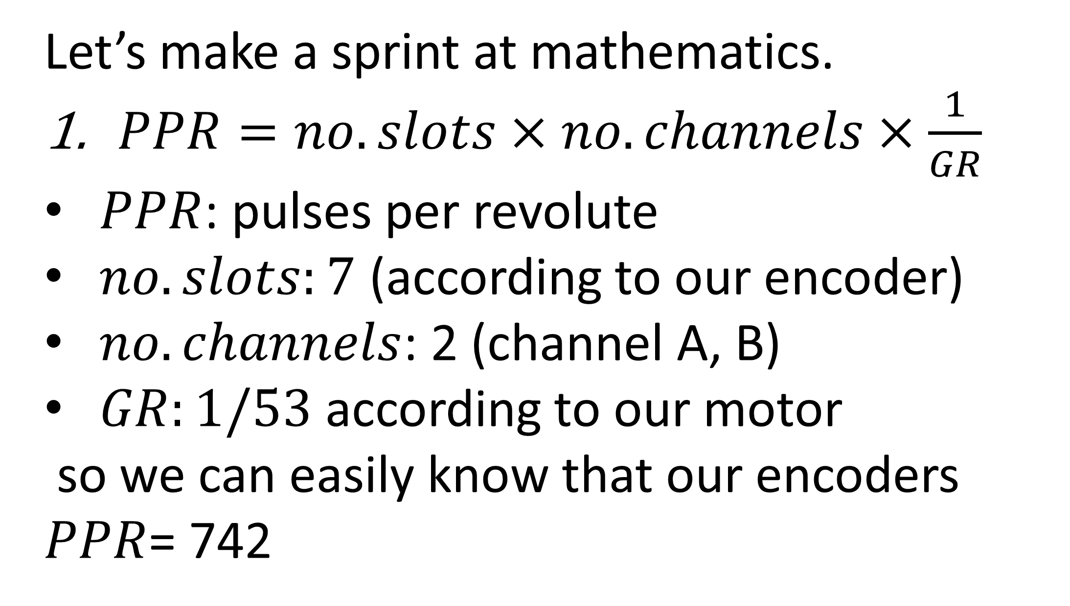
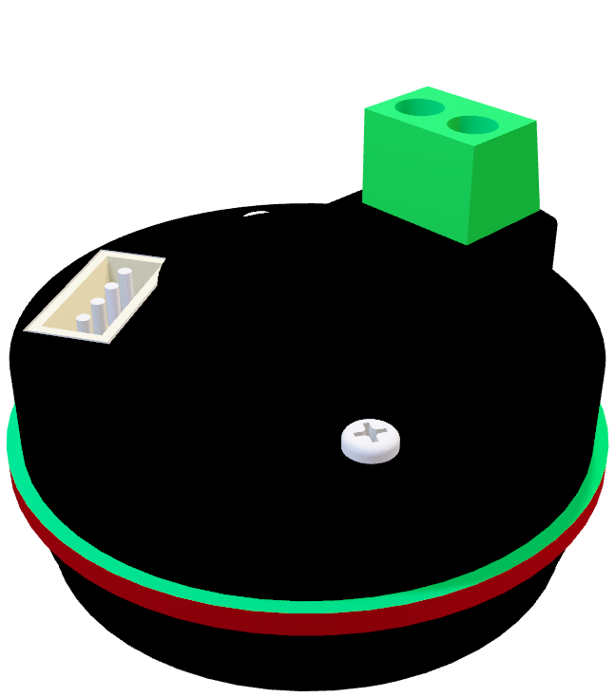
Let’s make a sprint at mathematics.
$PPR=no.slots×no.channels×\frac{1}{GR}$
$PPR$: pulses per revolute
$no.slots:7$ (according to our encoder)
$no.channels$: 2 (channel A, B)
$GR:1/53$ according to our motor
so we can easily know that our encoders
$PPR$= 742

Slide 35
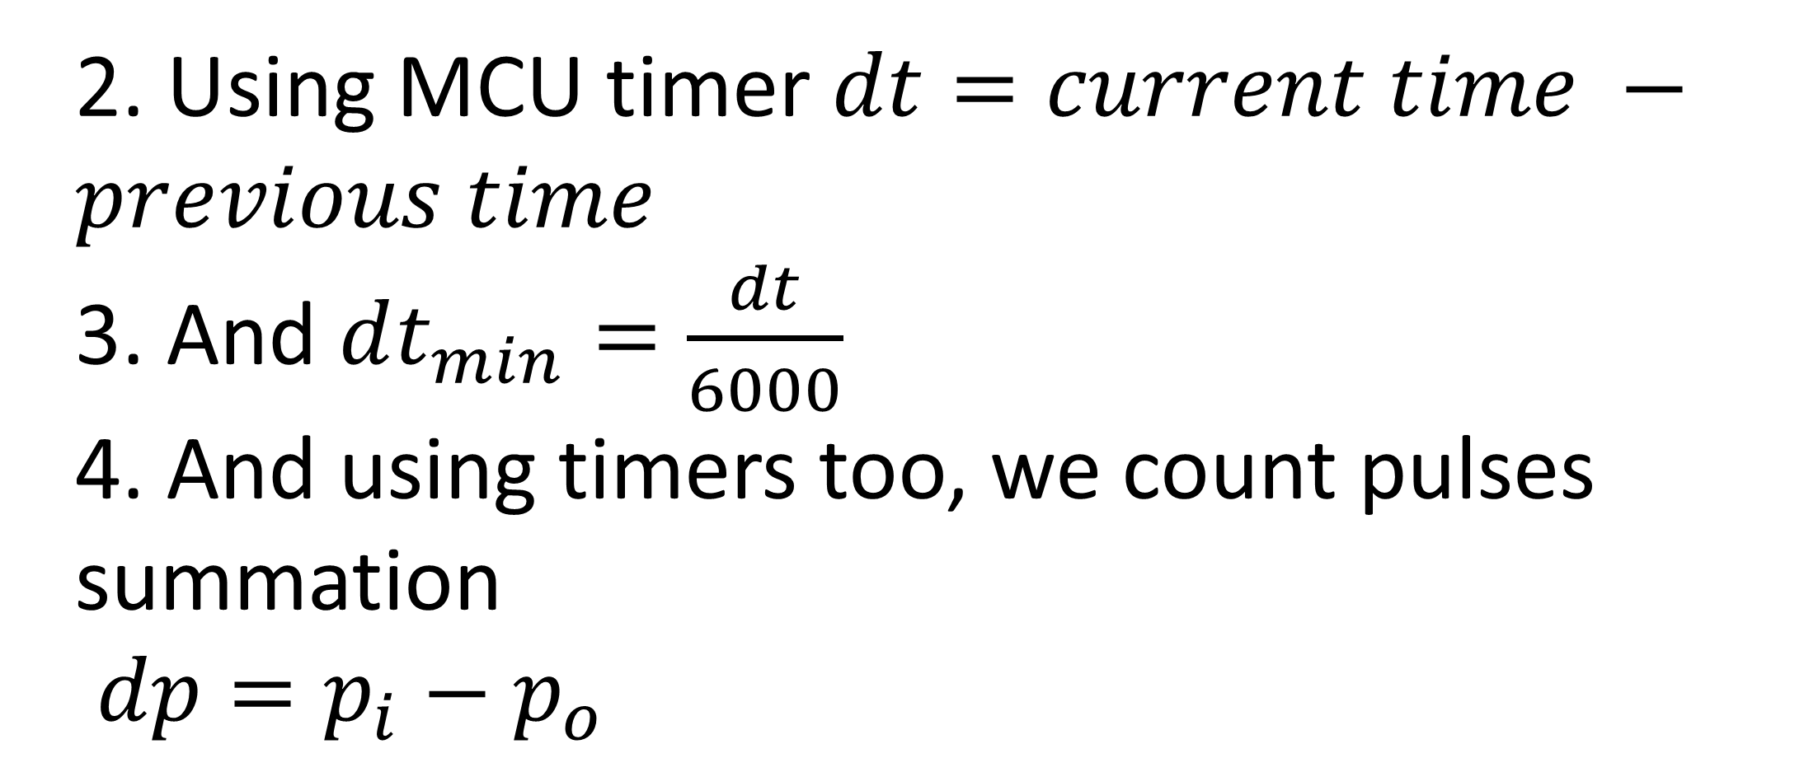
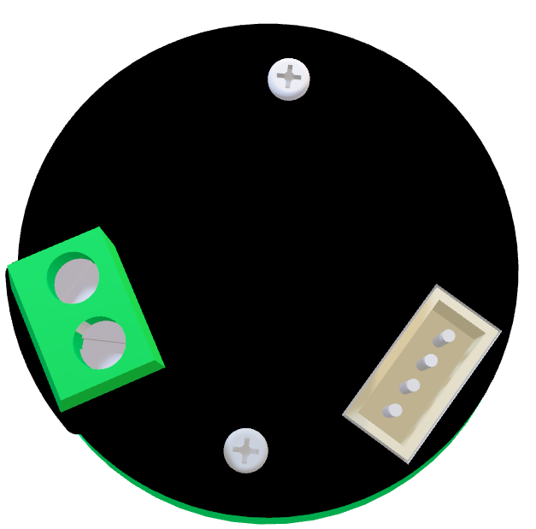
2. Using MCU timer $dt=current time −previous time$
3. And $dt_{min}=\frac{dt}{6000}$
4. And using timers too, we count pulses summation
$dp=p_{i}−p_{o}$

Slide 36
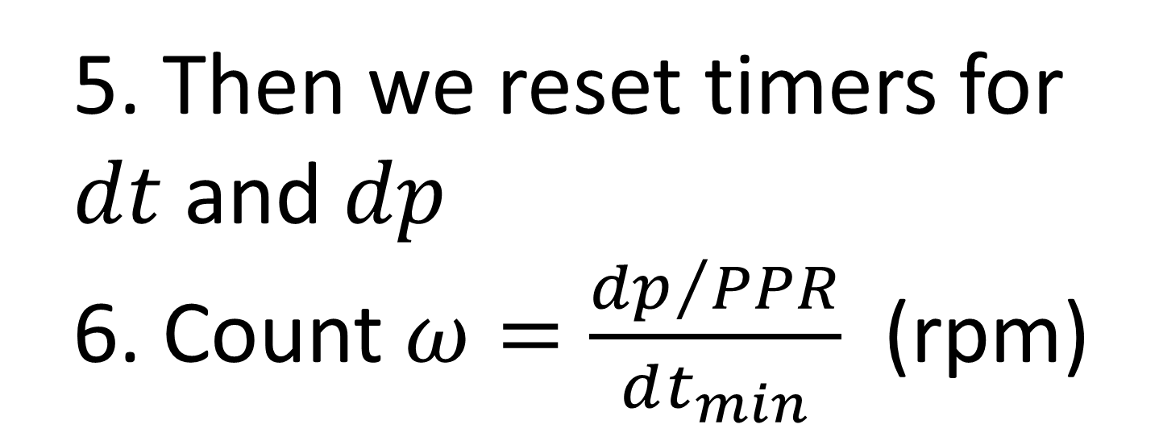
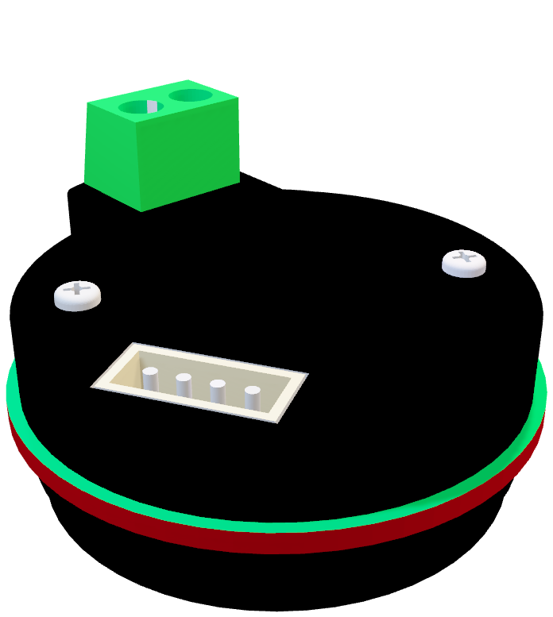
5. Then we reset timers for $dt$ and $dp$
6. Count $ω=\frac{{dp}/{PPR}}{dt_{min}}$ (rpm)

Slide 37
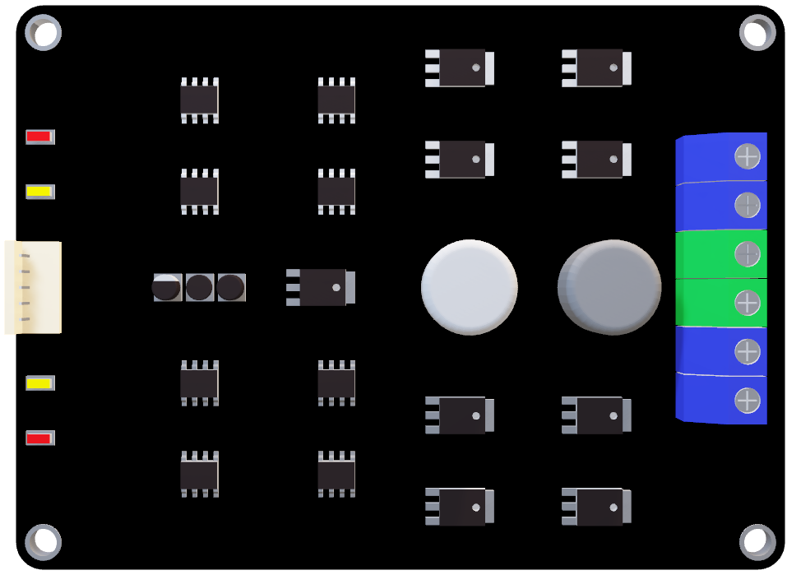
4. Cytron MDD10A (motor driver)
We get to our last component,
the motor driver. Simply, the motor driver work as gate to voltage to control motor speed. As it known for us that controlling speed using MCU need to PWM signal. And we also know that MCU maximum output is 5V.

Slide 38
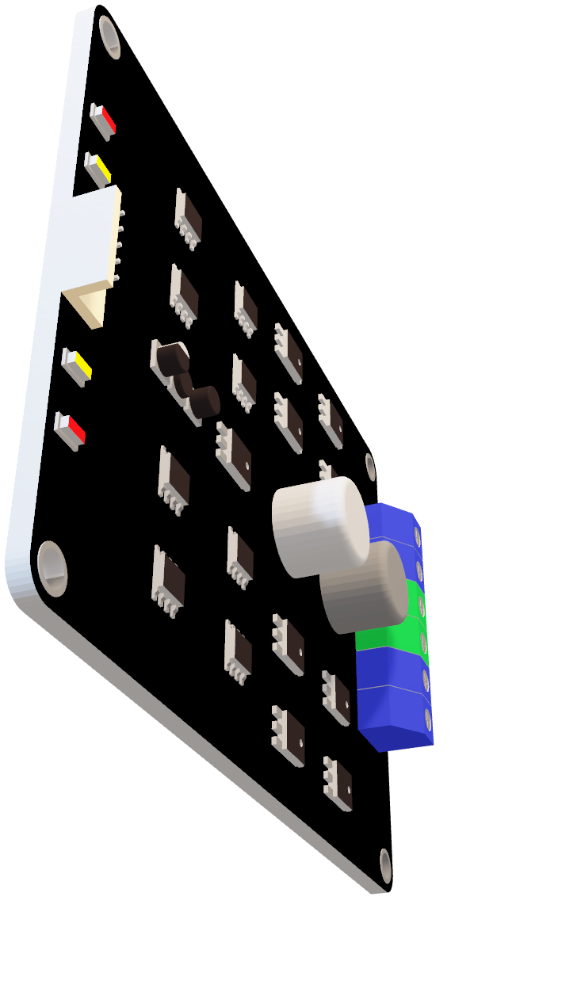
So, this motor driver works on amplifying this PWM signal to the need voltage for our motor specs. Also, it allows us to control this PWM signal pi-directional to have the ability to rotate CCW or CW

Slide 39
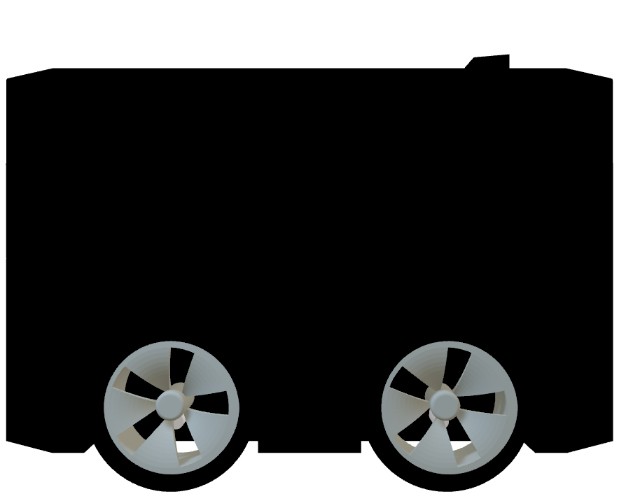
Robotics breaking ice

Slide 40
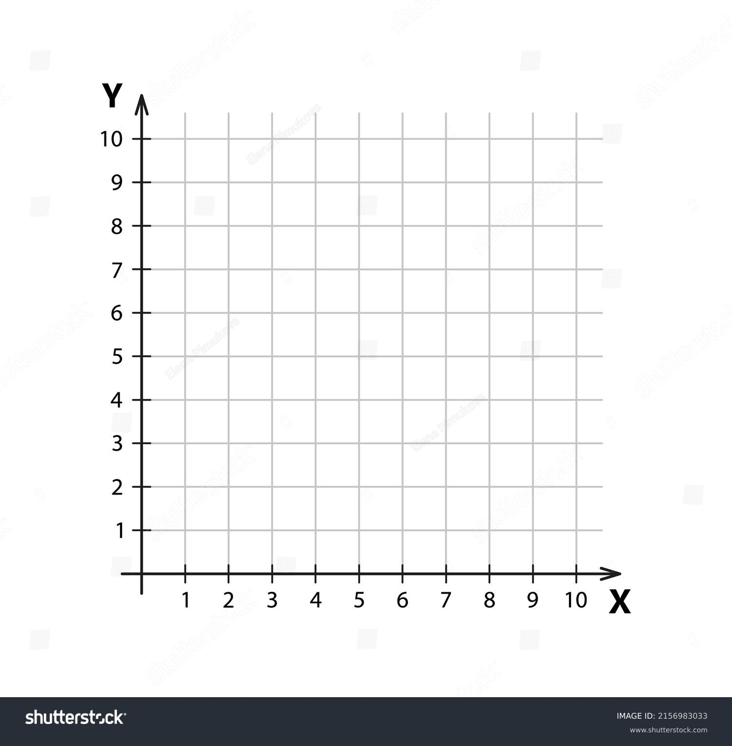
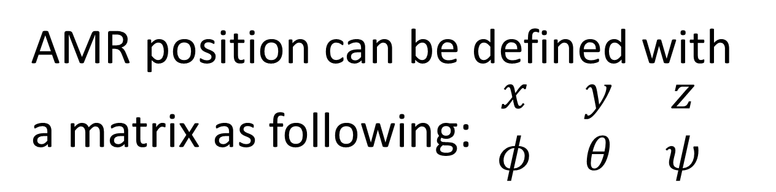

First thing we had to know is Translation Form.
AMR position can be defined with a matrix as following: $\begin{matrix}x & y & z \\ φ & θ & ψ\end{matrix}$

Slide 41
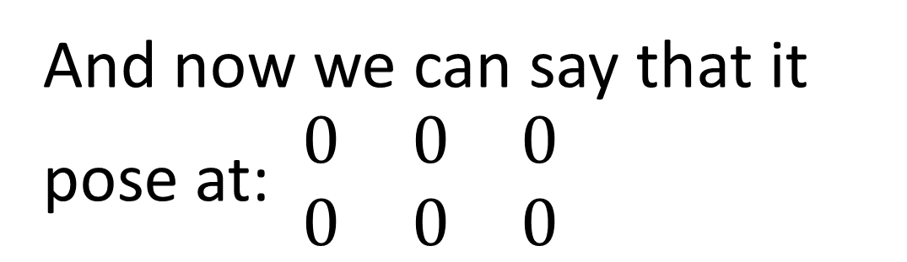
And now we can say that it pose at: $\begin{matrix}0 & 0 & 0 \\ 0 & 0 & 0\end{matrix}$

Slide 42
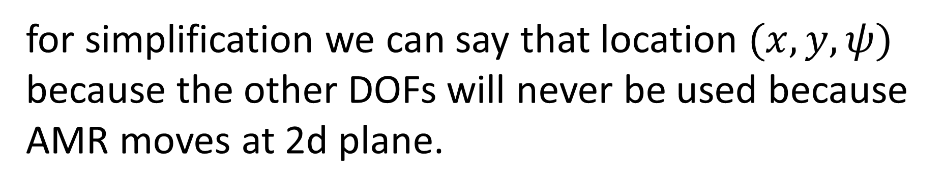
for simplification we can say that location $(x, y, ψ)$ because the other DOFs will never be used because AMR moves at 2d plane.

Slide 43
If AMR moved as it seen. Its pose would be (4, 5, ${45}^{o}$)

Slide 44
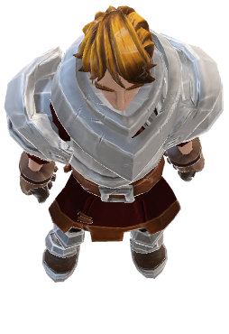
What if there is an obstacle front of AMR?

Slide 45
So the translation form of obstacle would be the summation of translation form from origin to robot and from robot to obstacle

Slide 46
$$TF_{obstacleToOrigin}=(x_{robot}+x_{robotToObstacle}, y_{robot}+y_{robotToObstacle})$$

Slide 47
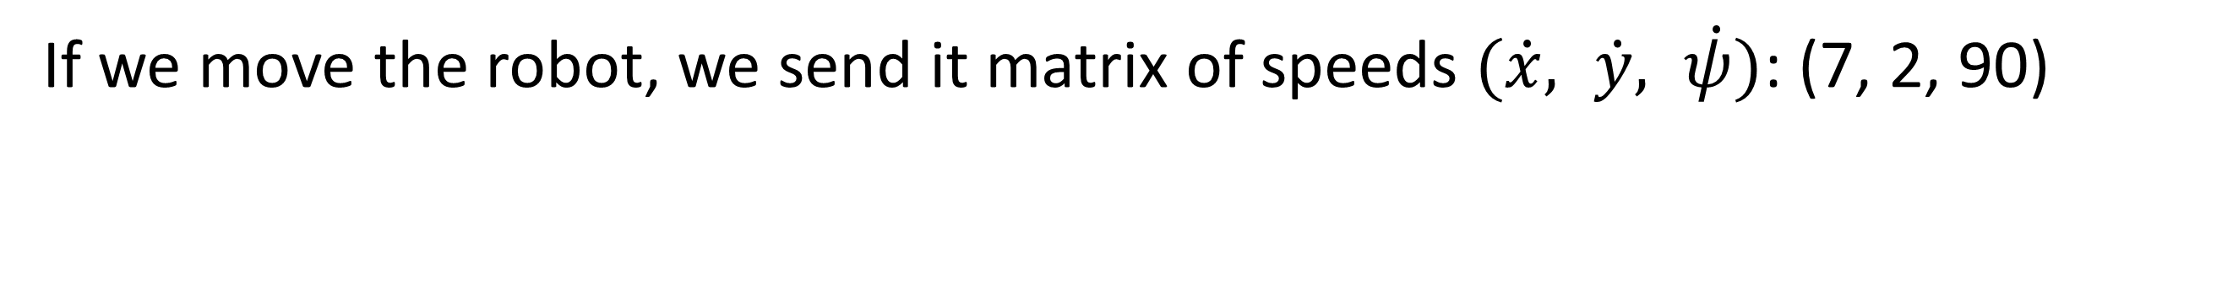
If we move the robot, we send it matrix of speeds $(\dot{x}, \dot{y}, \dot{ψ})$: (7, 2, 90)

Slide 48
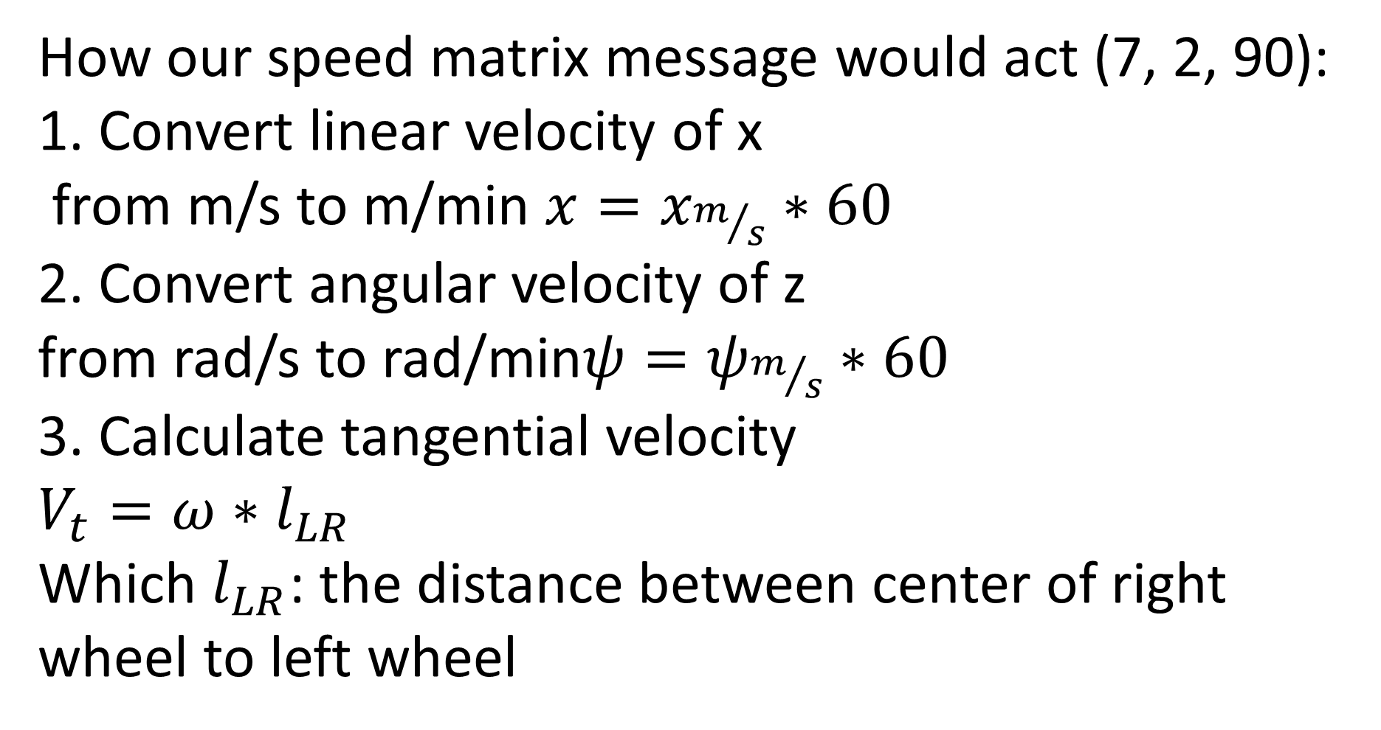
How our speed matrix message would act (7, 2, 90):
1. Convert linear velocity of x
from m/s to m/min $x=x_{m/s}∗60$
2. Convert angular velocity of z
from rad/s to rad/min$ψ=ψ_{m/s}∗60$
3. Calculate tangential velocity
$$V_{t}=ω∗l_{LR}$$
Which $l_{LR}$: the distance between center of right wheel to left wheel

Slide 49
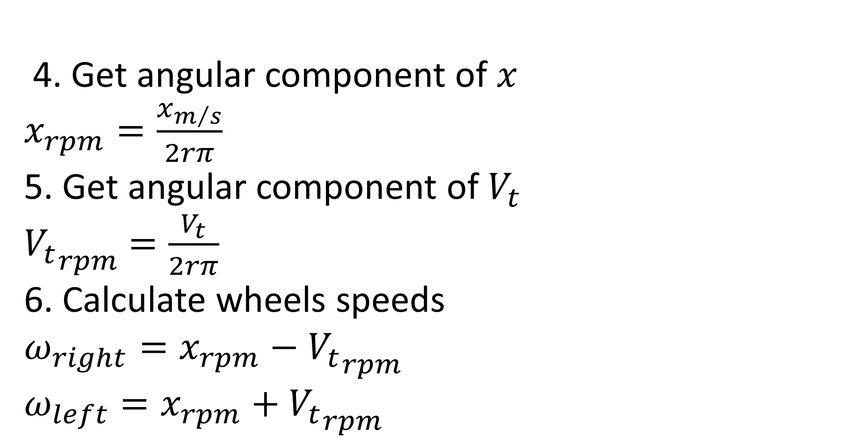
4. Get angular component of $x$
$x_{rpm}=\frac{x_{m/s}}{2rπ}$
5. Get angular component of $V_{t}$
${V_{t}}_{rpm}$ $=\frac{V_{t}}{2rπ}$
6. Calculate wheels speeds
$$ω_{right}=x_{rpm}−{V_{t}}_{rpm}$$
$$ω_{left}=x_{rpm}+{V_{t}}_{rpm}$$

Slide 50
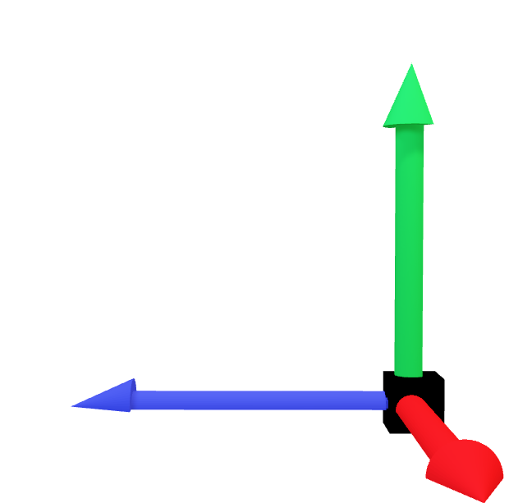
5. Odometery
Odemetery is our AMR backbone, simply it is the updatable feedback of TF which is initially, basic & needed sensing for robot to know where is it and how much walked away of origin.

Slide 51
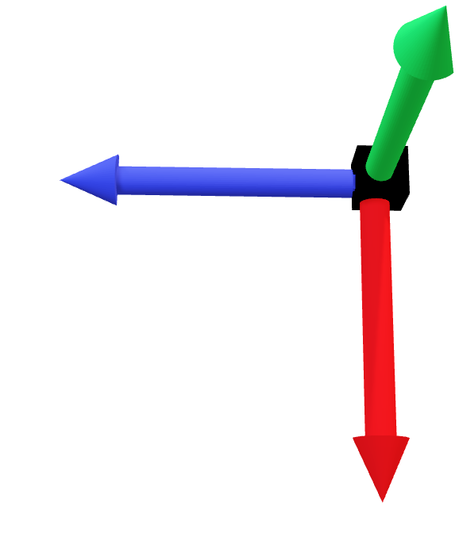
The odometery has several types:
Wheel feedback
Inertial odometery
Visual odometery
Laser odometery

Slide 52
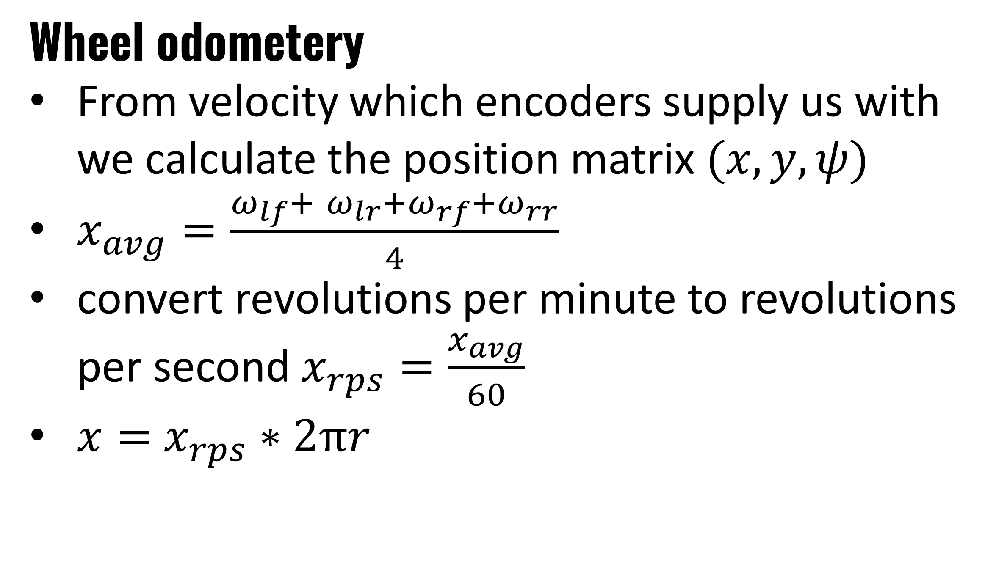
Wheel odometery
From velocity which encoders supply us with we calculate the position matrix $(x, y, ψ)$
$x_{avg}=\frac{ω_{lf}+ ω_{lr}+ω_{rf}+ω_{rr}}{4}$
convert revolutions per minute to revolutions per second$x_{rps}=\frac{x_{avg}}{60}$
$x=$ $x_{rps}∗2πr$

Slide 53
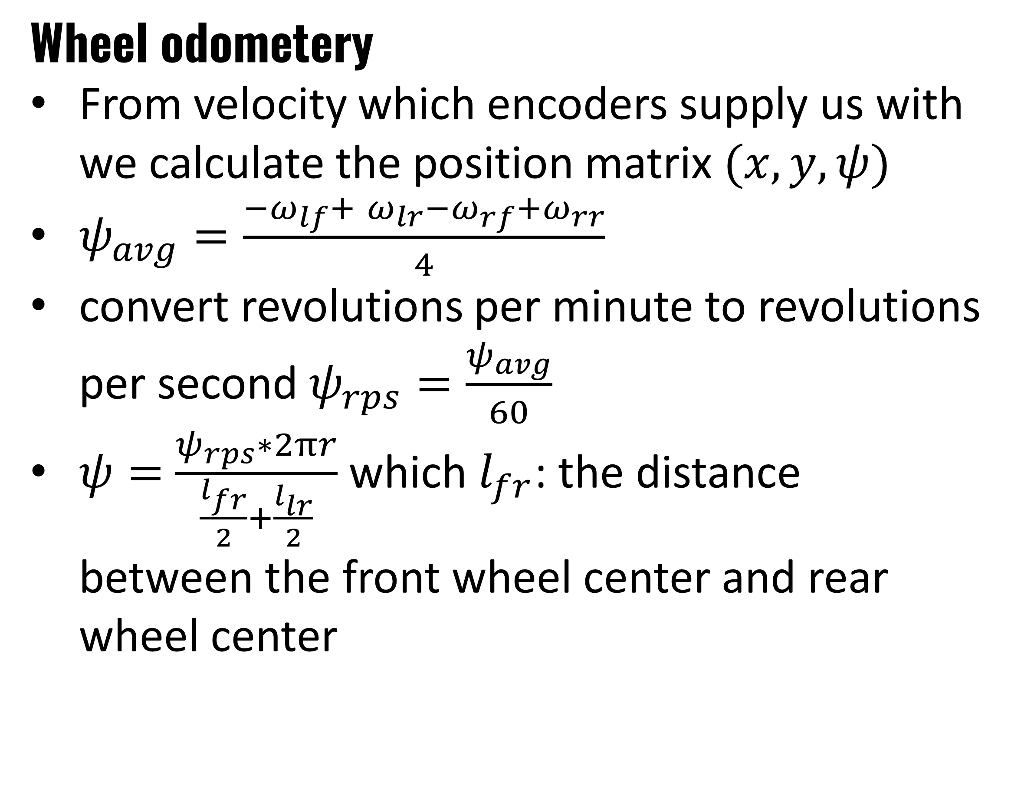
Wheel odometery
From velocity which encoders supply us with we calculate the position matrix $(x, y, ψ)$
$ψ_{avg}=\frac{{−ω}_{lf}+ ω_{lr}−ω_{rf}+ω_{rr}}{4}$
convert revolutions per minute to revolutions per second$ψ_{rps}=\frac{ψ_{avg}}{60}$
$ψ=$ $\frac{ψ_{rps}∗2πr}{\frac{l_{fr}}{2}+\frac{l_{lr}}{2}}$ which $l_{fr}$: the distance between the front wheel center and rear wheel center

Slide 54
Wheel odometery
From velocity which encoders supply us with we calculate the position matrix $(x, y, ψ)$
$ψ_{avg}=\frac{{−ω}_{lf}+ ω_{lr}−ω_{rf}+ω_{rr}}{4}$
convert revolutions per minute to revolutions per second$ψ_{rps}=\frac{ψ_{avg}}{60}$
$ψ=$ $\frac{ψ_{rps}∗2πr}{\frac{l_{fr}}{2}+\frac{l_{lr}}{2}}$ which $l_{fr}$: the distance between the front wheel center and rear wheel center

Slide 55
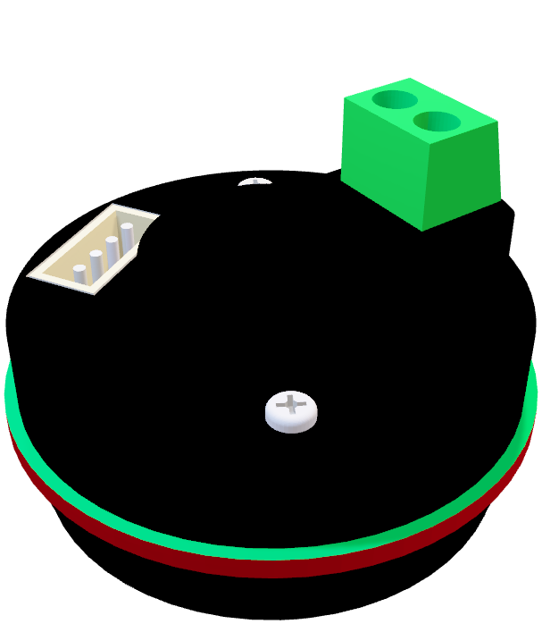
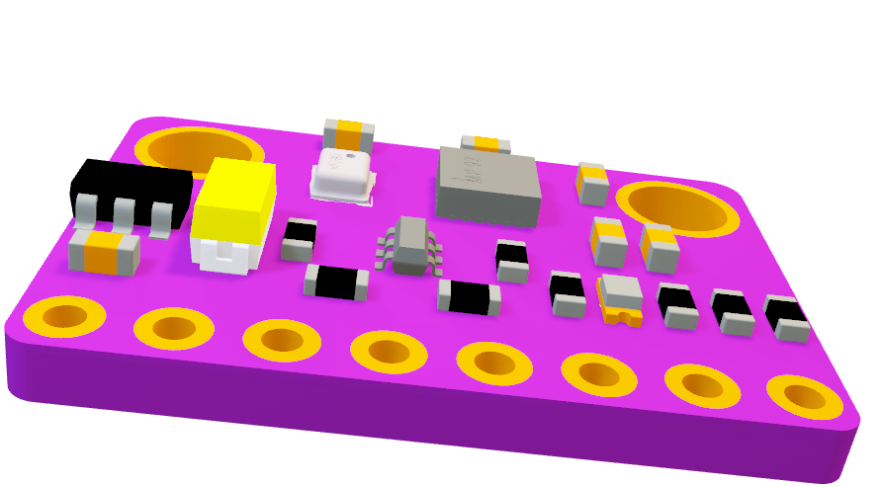
Kalmn Filter
After getting this initial odometery we found that it isn’t enough simply because if the wheels move on unlevel land this odom will be usless. so., we saw that we had to depend on different sources for odom which are IMU & encoders

Slide 56
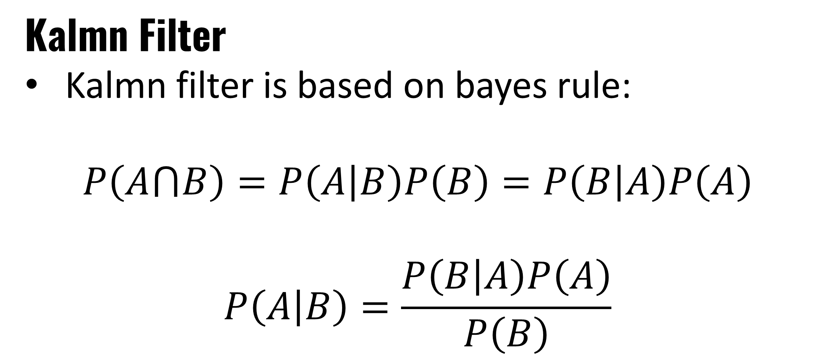
Kalmn Filter
Kalmn filter is based on bayes rule:
$$P\left(A⋂B\right)=P\left(A | B\right)P\left(B\right)=P\left(B | A\right)P\left(A\right)$$
$$P\left(A | B\right)=\frac{P\left(B | A\right)P\left(A\right)}{P\left(B\right)}$$

Slide 57
Kalmn Filter
Using Kalmn filter we could improve our odometery feedback response

Slide 58
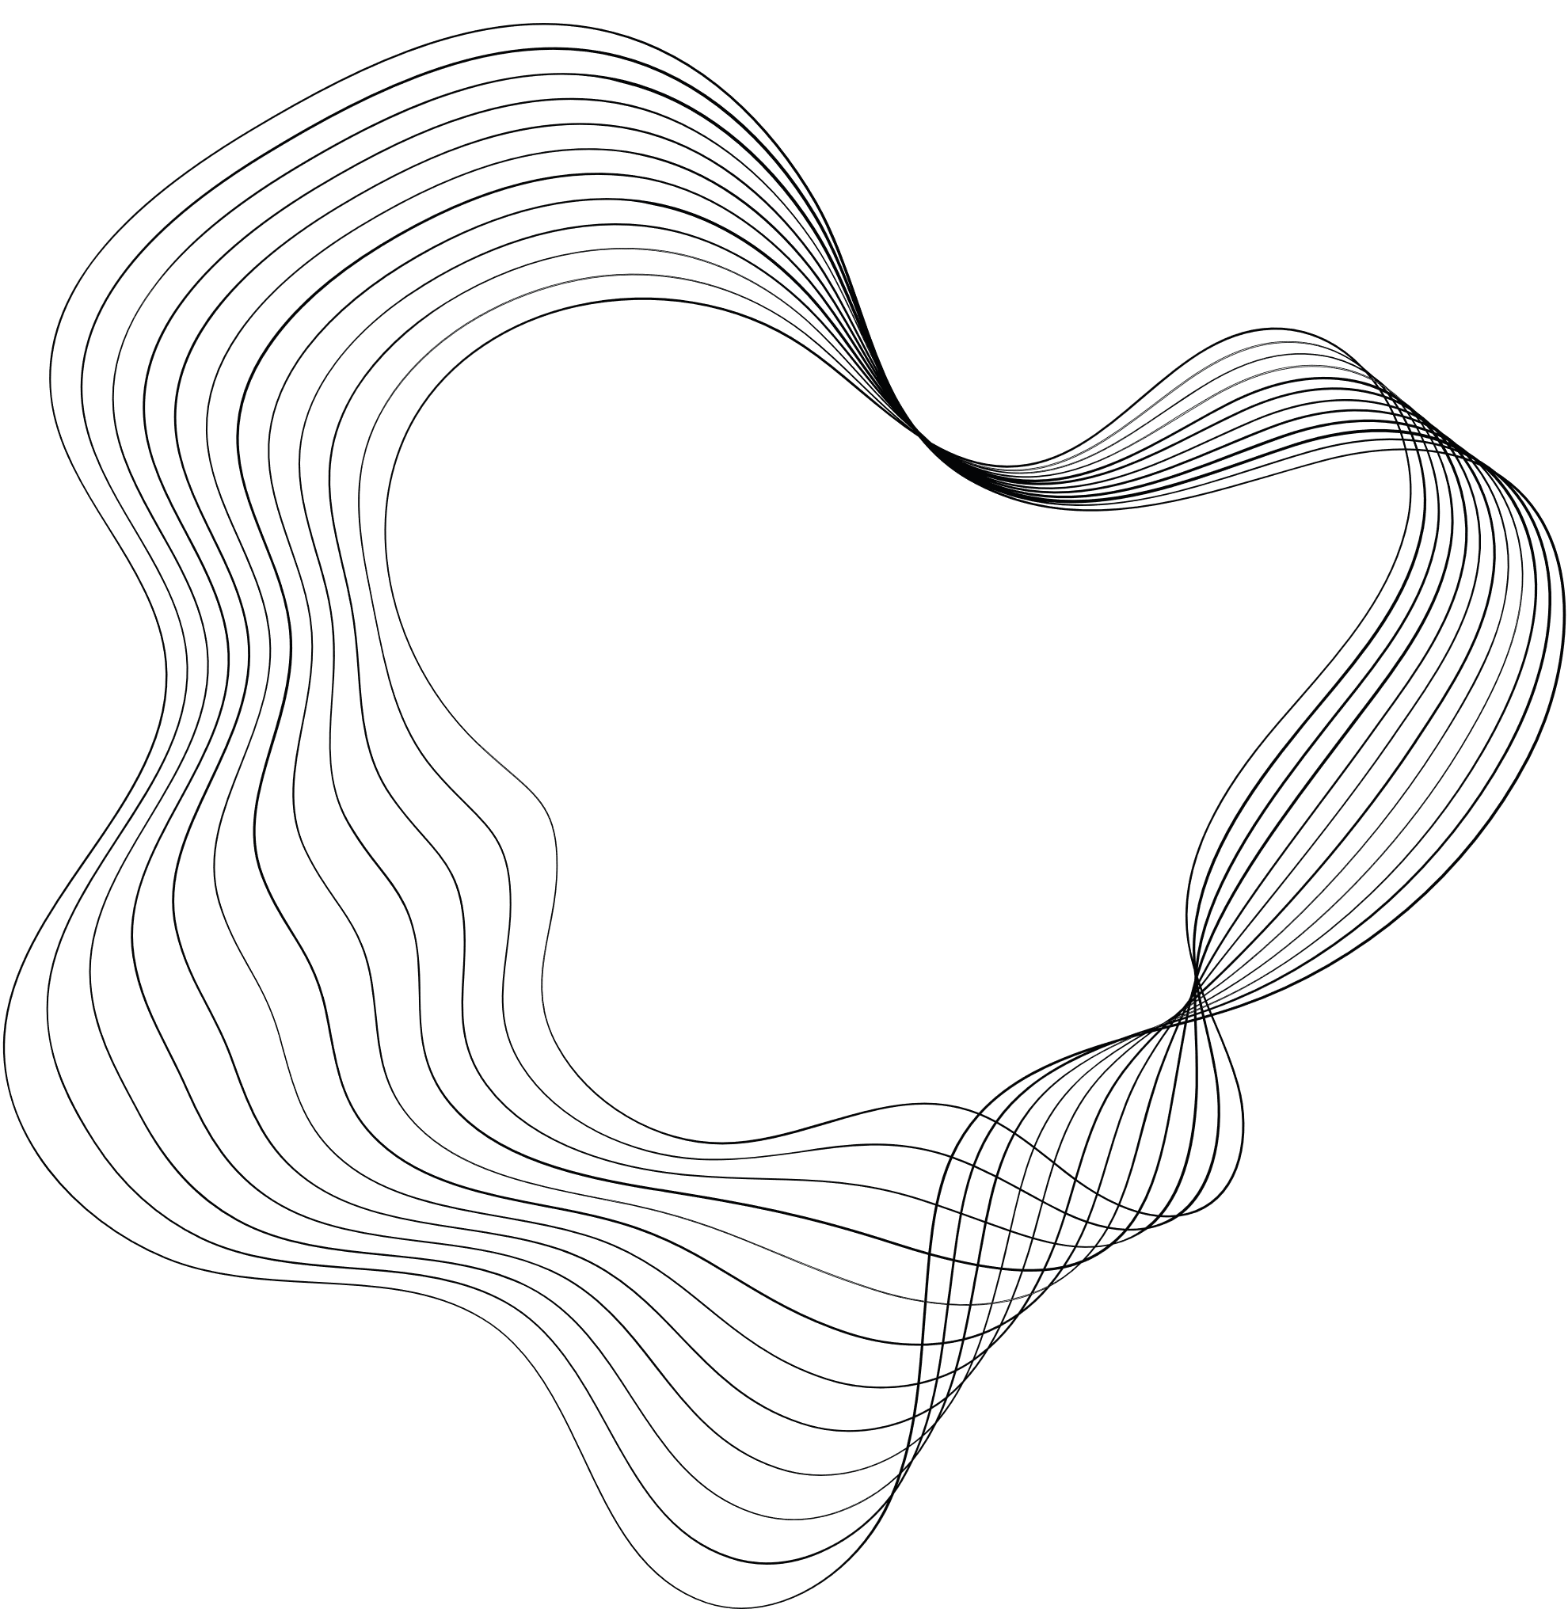


LARANA, INC.
THANK'S FOR LISTENING

